Slide 1
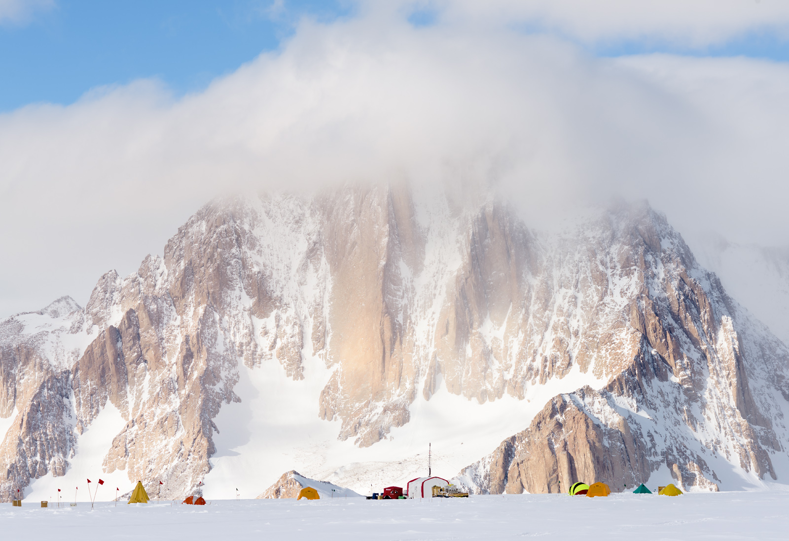
U.S. Ice Drilling Program
Sub Glacial Rock Coring and Agile Ice Coring Drills
Greenland Ice Sheet Stability – Lessons from the Past
University of Bergen, April 19-21, 2023
Jay Johnson
IDP Mechanical Engineer / Project Manager
University of Wisconsin-Madison

Slide 2
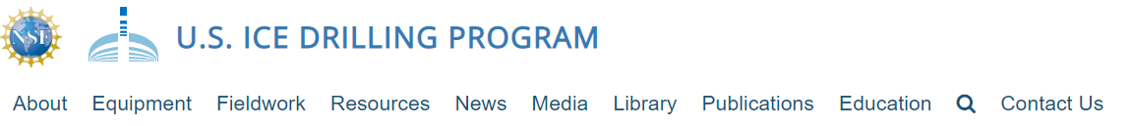
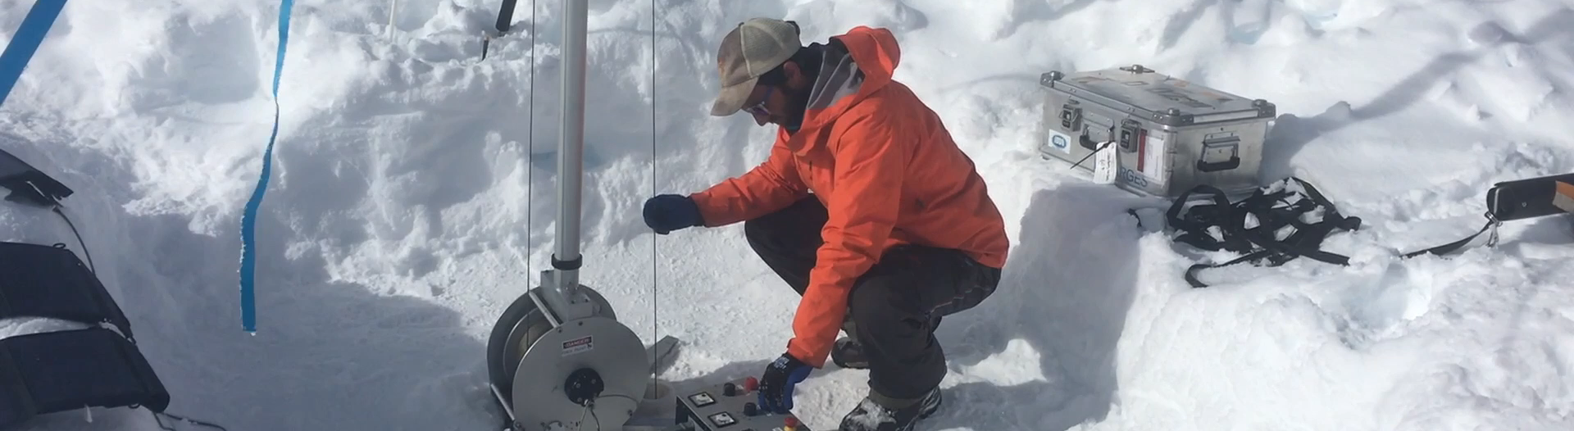
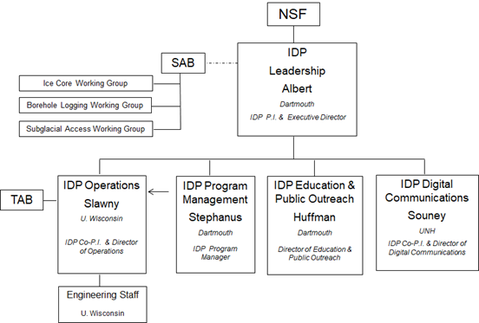



https://icedrill.org
The U.S. Ice Drilling Program (IDP) was established by the National Science Foundation (NSF) to lead integrated planning for ice coring and drilling and provision of drills and drilling services.
PRIMARY SERVICES PROVIDED:
  Integrated Long Range Planning to enable successful field campaigns in the polar regions and on mid-latitude glaciers
  Technology development (drills, logging winches, etc.) at IDP at the University of Wisconsin-Madison
  Field project support through the provision of ice/rock drilling and logging equipment as well as driller services
  Education and Outreach
  Proposal support for investigators
  Custodianship of much of NSF’s fleet of polar ice and rock coring equipment
Notes:
Supporting 7 Arctic projects this year. Sending drillers on three of the projects. 5 Antarctic projects for the 23/24 season.

Slide 3
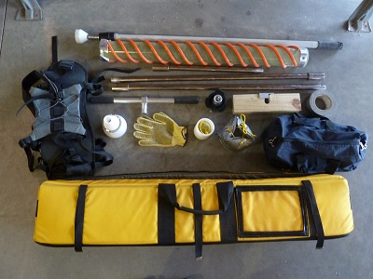
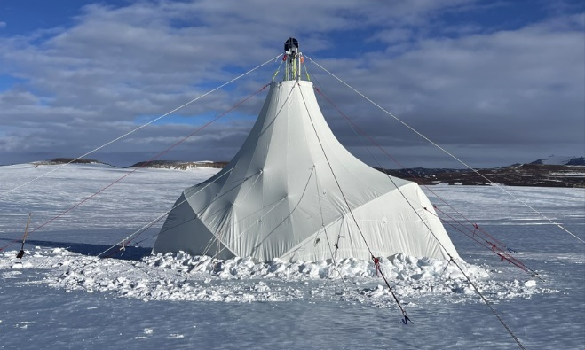
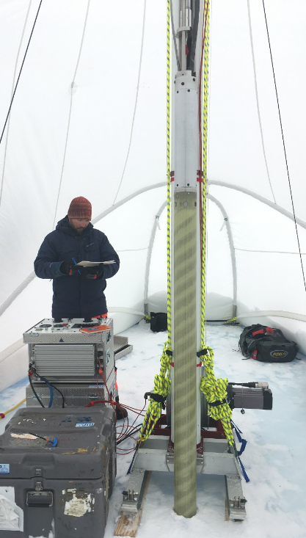
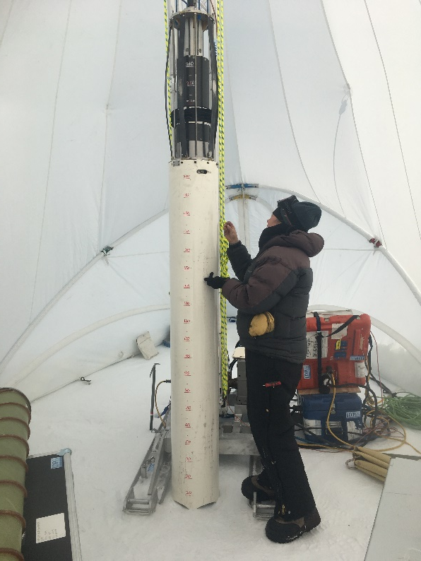
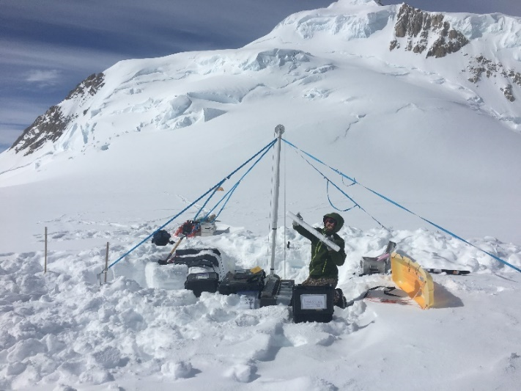
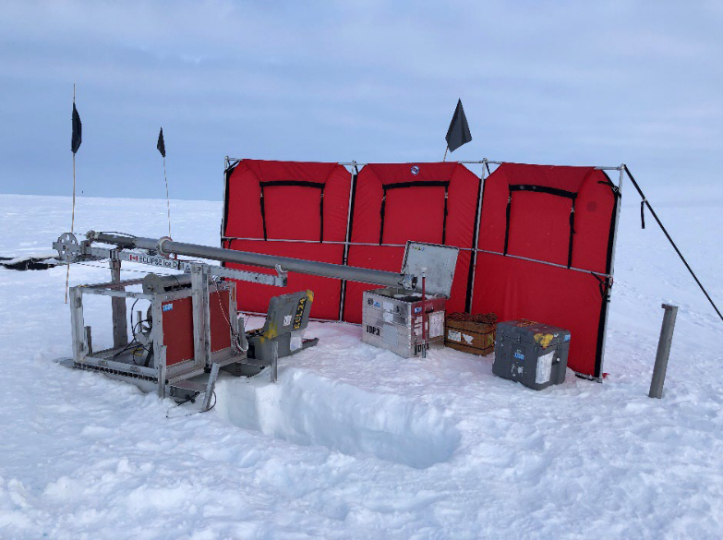
IDP Agile Ice Coring Drills:
Hand Augers, Prairie Dog, Sidewinder
  76 and 102 mm (3 and 4 inch) core diameters
  0 – 40 meters depth range (max with Sidewinder winch)
  100 – 200 lbs. shipping weight
  6 m – 2 hrs., 30 m – 8 hrs.
Shallow Ice Coring Drills (Stampfli, Eclipse, Foro 400, and BID)
  51, 76, 98 and 241 mm (2, 3, 3.9, and 9.5 inch) core diameters
  0 – 400 meters depth range (dry)
  400 – 4500 lbs. shipping weight
  Requires 1-2 IDP Drillers to operate
  100 m ~ 30 hrs., 200 m ~ 75 hrs.
Hand Auger
Foro 400/BID Tent
Stampfli Drill
Eclipse Drill
Foro 400 Drill
Blue Ice Drill

Slide 4
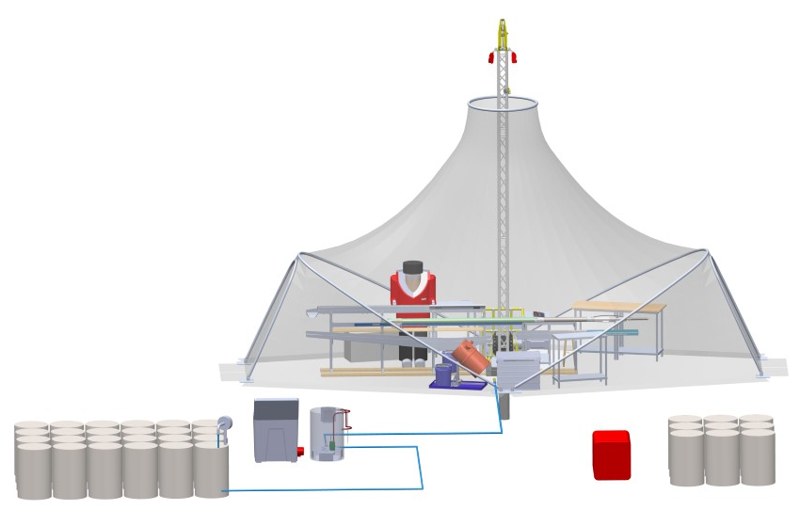
IDP Agile Ice Coring Drills:
700 Drill (In Development)
  70 mm (2.75 inch) core diameter x 1 m long
  0 – 700 meter depth range (wet drilling)
  16,500 lbs. estimated shipping weight (Drill: 4500 lbs. & Consumables: 12,000 lbs.)
  Requires 3 IDP Drillers to operate

Slide 5
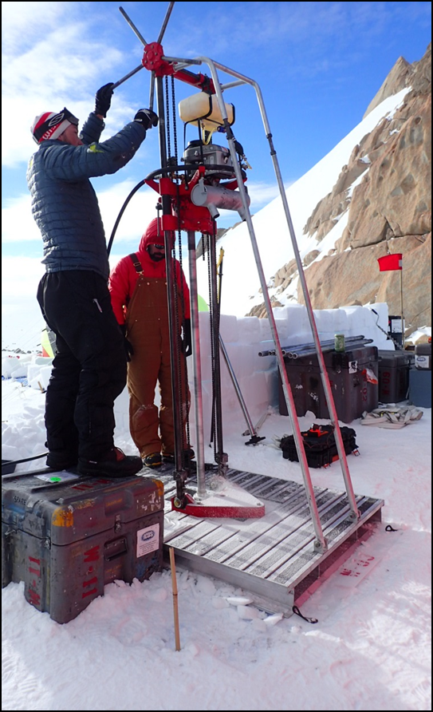
IDP Bedrock Coring Drill Systems:
Winkie Drill
Agile Sub-Ice Geological (ASIG) Drill
Basil Access Sampling and Exploration (BASE) Drill
  Designed to drill through firn/ice to reach bedrock for subglacial sampling
  Firn cored or augered to reach impermeable ice
  Permeable layers are cased and sealed to impermeable ice with an inflatable packer
  Ice drilled in a continuous manner with a full-face bit
  Ice and rock core recovery via wireline (ASIG and BASE drills only)
  Continuous drilling fluid circulation and chip filtration
  Drilling fluid can be recovered/reused at project completion
  ***Requires frozen subglacial environment***

Slide 6
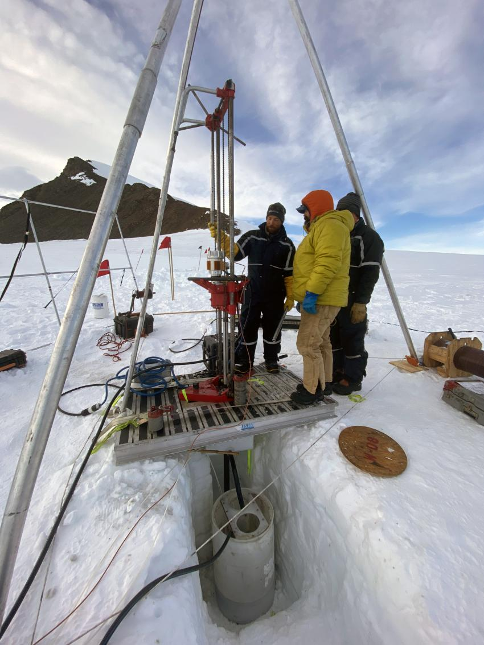
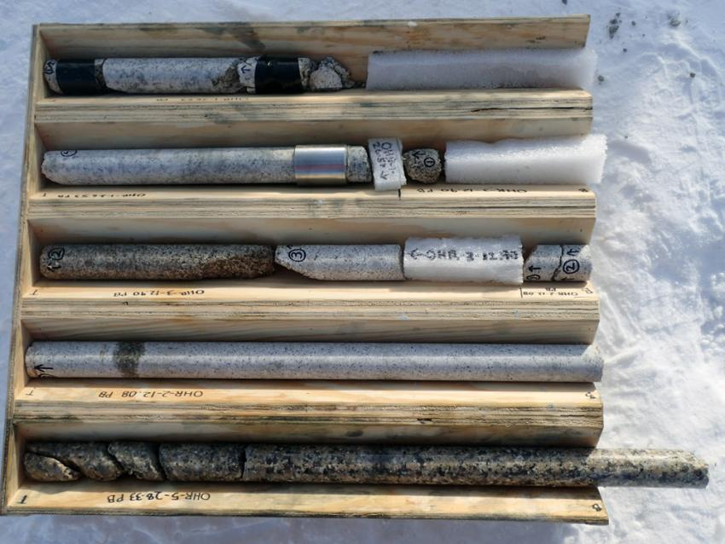
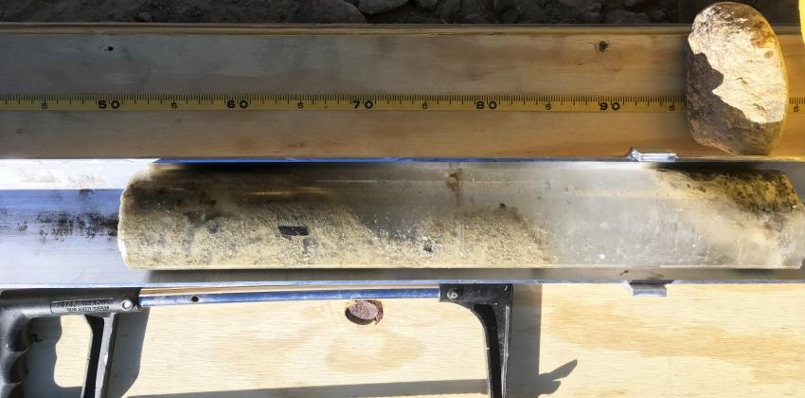
Winkie Drill Specifications
Drill Type | Surface Driven Rock Coring Rig
Power Unit | Brushless DC Electric Motor, 3kW
Drill Sting | Rigid, Single Wall Drill Rod
Rod Tripping Mechanism | Tripod with Capstan Winch
Drill Fluid | Isopar K
Fluid Filtration | Yes, Gravity Forced Filter Bags
Set up | 1-3 people, 4 hours in good conditions
Operation | 2-3 people
Drilling rate | 3-5 m/hr. ice/dirty ice, .3-5 m/hr. in rock
Logistics | 4,300 lb. min, Twin Otter & Helicopter transportable
Rod/Core Barrel Configuration | AW34 | 86T2
Core Size [mm] | 33.4 | 71.7
Maximum Core Length [m] | 1.5 | 3
Available Bit Configuration | Impregnated, GeoSet, PDC | Impreganted, GeoSet, PDC
Depth Capacity [m] | 120 | Untested
Drill Rod Material [-] | Aluminum (steel couplers) | Steel
Rod Weight [lbs/m] | 5.9 | 11.3

Slide 7
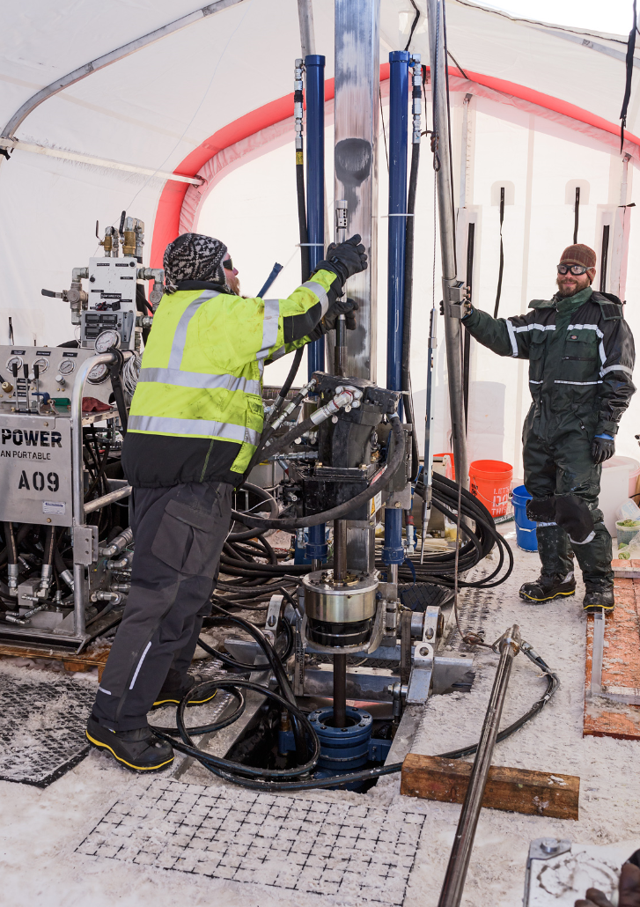
ASIG Drill Specifications
Drill Type | Surface Driven Rock Coring Rig
Power Unit | 4ct. Kubota D1105-T-E35B Diesel Engines (33 hp each)
Drill Sting | Rigid, Single Wall Drill Rod (Sandvik WL56)
Rod Tripping Mechanism | Rig mast hydraulics/chuck
Drill Fluid | Isopar K (Exxon-Mobil)
Fluid Filtration | Continuous - shaker table, secondary filter, chip melter
Rod/Core Barrel Configuration | Sandvik WL56 thin-kerf metric
Core Size [mm] | 39 (larger core possible with different drill rod)
Maximum Core Length [m] | 1.5 or 3.0
Available Bit Configuration | Hardened Steel (ice), Diamond-impregnated, GeoSet, PDC
Depth Capacity [m] | 700 (~1500 m max with modifications, needs testing)
Drill Rod Material | Steel
Rod Weight [lbs/m] | 8.5 (for 39 mm core)
Set up | 2-3 people, 30 hours in good conditions
Operation | 2-3 Drillers and 1-2 core handlers
Time-to-Depth | 50 hrs. for 200 m, 10 m rock; 100 hrs. est. for 700 m, 10 m rock

Slide 8
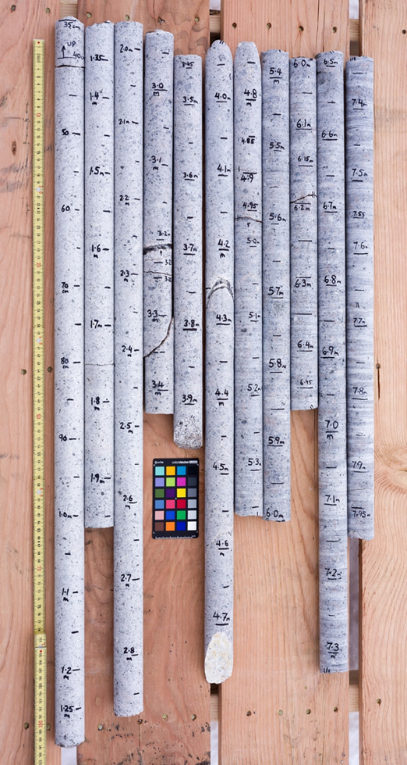
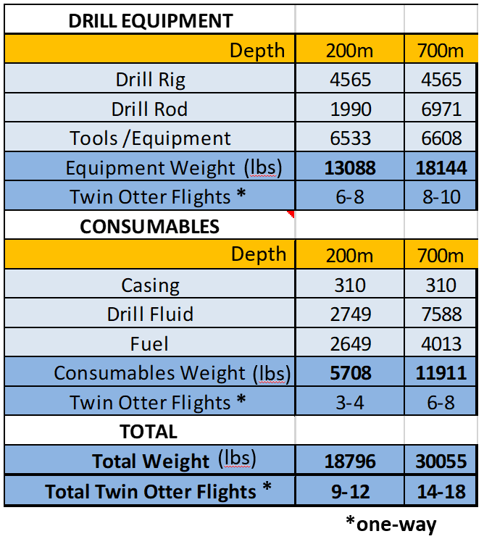
ASIG Drill Transport Logistics
System deployed via light aircraft, heavy-lift aircraft, or tractor traverse
Heavy equipment not needed for assembly, but does speed up operations
  600 lbs. max single-piece weight
Weight is highly dependent upon project requirements
  # of holes
  Firn depth
  Bedrock depth
  Spares*
*Spare components and extra drilling fluid improve project success but increase system weight significantly.
Sample System Weights for Shallow and Deep Projects

Slide 9
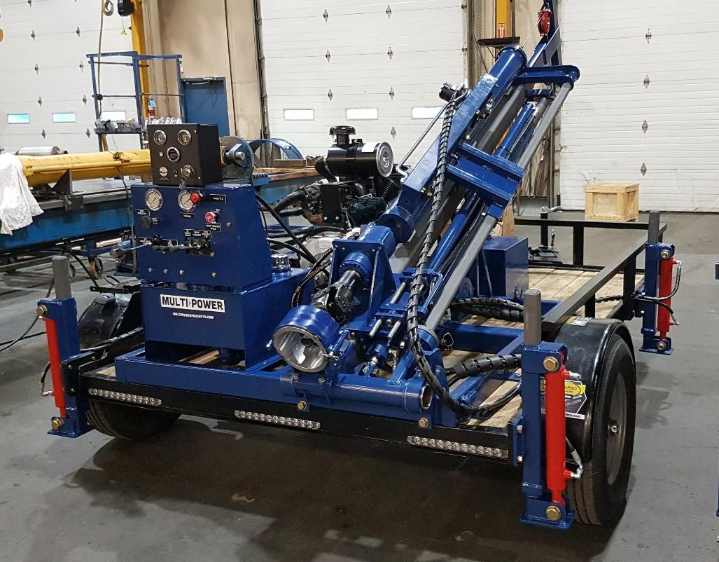
BASE Drill
Drill rig is being designed and fabricated by Multi-Power Products.
  Anticipating delivery in Nov 2023
IDP will build the supporting systems and purchase the down-hole tooling
Drill Type | Top Drive Rock Coring Rig
Power Unit | 2ct. 38 hp Kohler gas engines (Can run on one engine)
Drill Sting | Rigid, Single Wall Drill Rod (Sandvik WL56)
Rod Tripping Mechanism | Rig mast hydraulics
Drill Fluid | Isopar K (Exxon-Mobil)
Fluid Filtration | Continuous - shaker table, secondary filter, chip melter
Rod/Core Barrel Configuration | Sandvik WL56 thin-kerf metric
Core Size [mm] | 39 (larger core possible with different drill rod)
Maximum Core Length [m] | 1.5
Available Bit Configuration | Hardened Steel (ice), Diamond-impregnated, GeoSet, PDC
Depth Capacity [m] | 200
Drill Rod Material | Steel
Rod Weight [lbs/m] | 8.5 (for 39 mm core)
Example of a similar sized rig MPP will use as the starting point for the BASE Drill Rig design.

Slide 10
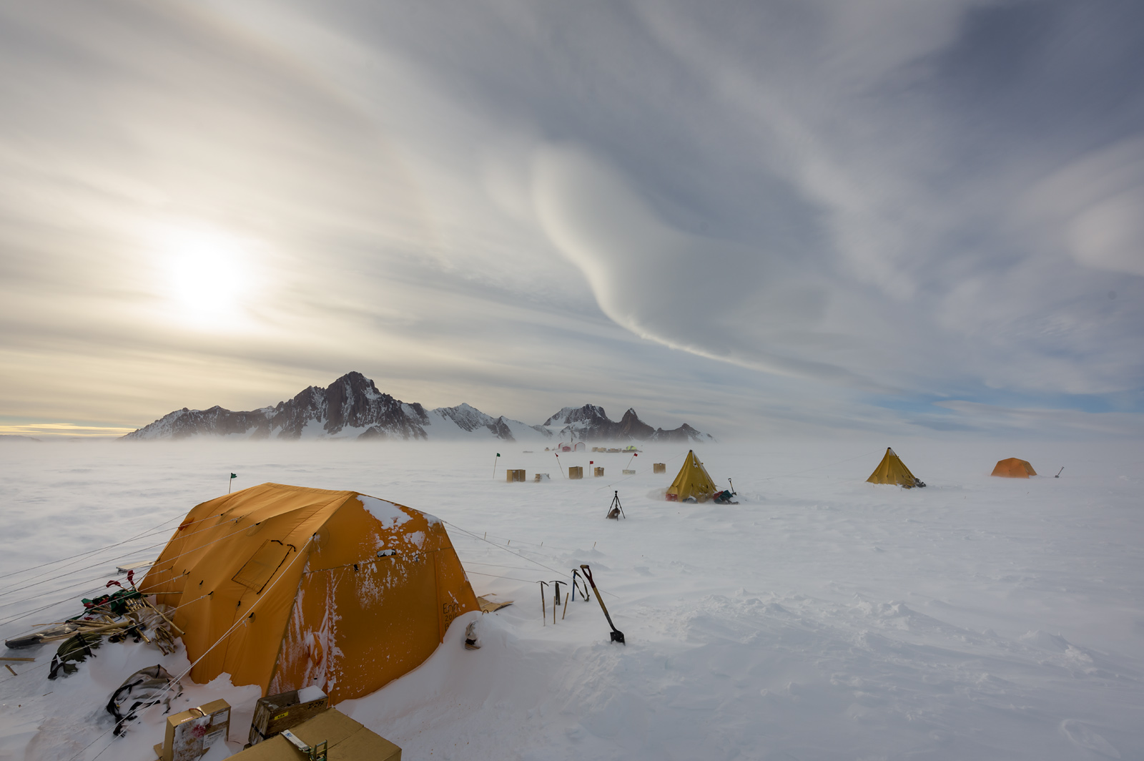
For more information visit: icedrill.org instagram.com/us_icedrilling twitter.com/US_IceDrilling facebook.com/UsIceDrillingProgram youtube.com/user/USIceDrillingVideos
Thank you!

