Slide 1
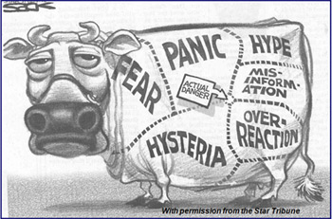

November 2014
VUELCO
Legal aspects of Risk Communication
richard.bretton@bristol.ac.uk

Slide 2

UEA 2/41
18 March 2014
The roles of law
4 recent cases
Lessons from case law

Slide 3
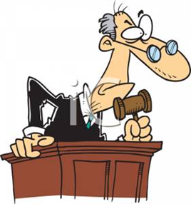

The roles of law

Slide 4
The roles of law

Slide 5
European Convention of Human Rights Cases
Budayeva v Russia (2008)
Town protected from Natural mudslides by a mud collector & dam – Both damaged in August 1999 & funds requested for repairs – No remediation – Mudslides in July 2000 – 8 killed and homes destroyed
Kolyadenko v Russia (2012)
Natural flash flood – Release of water from dam without warning – Damage to flats & belongings

Slide 6
States have a positive duty under Article 2 (the right to life) to take appropriate steps to safeguard the lives of Citizens
Legislative & administrative framework designed to provide effective deterrence against threats to the right to life
Before the event, regulatory measures
    to identify hazards, assess and control their risks
    to have a supervisory system to encourage those responsible to adequate safety steps
    to establish coordination & cooperation between administrative authorities COMMUNICATION
    to set in place an emergency warning system
    to inform citizens of the risks COMMUNICATION

Slide 7
States have a positive duty to take appropriate steps to safeguard the lives of Citizens
    After the event, when lives have been lost
      A prompt, diligent, independent & impartial official investigation to ascertain:
        What happened and any shortcomings
        The State officials & authorities involved
This enquiry may lead to & assist criminal prosecutions and/or claims for compensation from bad COMMUNICATION

Slide 8
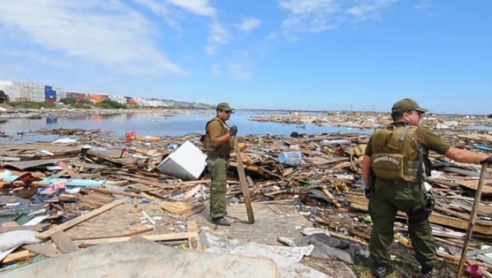
  National law – Civil claims
  Garcés v Chile (2013)
Mario Segundo Ovando Garcés, a resident of Santa Clara, Talcahuano
27 February 2010, in the wake of 8.8 magnitude earthquake, he heard the Regional Governor dispel the risk of a tsunami on a local radio station and decided not to evacuate his home
20 minutes later a tsunami killed Mario & 300+ other people

Slide 9

  Garcés v Chile (2013)
Chilean Navy runs the Hydrographic & Oceanographic Service (SHOA)
SHOA admitted after the tsunami that it :
  had made errors; &
  given unclear information to government officials who issued an alert, withdrew it, only to reissue it after the event!
Supreme Court of Chile:
  held the State responsible for Mario's death; &
  awarded his dependants over US$100,000 compensation

Slide 10
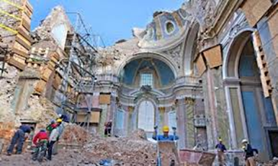
  National law – Criminal Prosecution
  L'Aquila, Italy (2012)
  At trial, 6 scientists & 1 government official
  convicted & sentenced to 6 years imprisonment
  On appeal, 6 scientists acquitted
  Manslaughter convictions were condemned by most scientific organisations
  Highlighted a number of Risk governance challenges

Slide 11
Exposure
Allegation
Communication between the Major Risk Committee (CGR) and the public not as planned & as required by law
It was direct and not via the Civil Protection Department (DPC) – a filter imposed by law
The direct communication…amplified the effectiveness of the reassuring message producing devastating effects on the precautionary habits traditionally followed by the victims (29 out of 309)
Unmitigated
Risk
"The culpable conduct of the defendants resulted in an unambiguously reassuring effect" Judge
Vulnerability
" filter for the selection of information … and the forms & means of communication" Judge
Contextual
Social & Economic fragility +
Lack of resilience or capacity to cope & recover
Second order effects
Non-hazard dependent

Slide 12
  L'Aquila, Italy (2012)
  The trial judge considered in detail:
  The causal link between CGR and the victims' deaths
  The theory of risk communication
    Data itself – Neutral
    Information provider – CGR had goals (i.e. risk mitigation)
    Information recipients – are biased by their previous knowledge & backgrounds
  What was the aim of the CGR's communications
  What were the characteristics of L'Aquila residents

Slide 13
  L'Aquila, Italy (2012)
  The trial judge considered in detail:
  'Scientific laws'
    Based upon cultural anthropology
    Model of "social representation"
  Rules of experience
    Based upon psychology
    'an empirical generalisation of common sense'

Slide 14
  L'Aquila, Italy (2012)
  The trial judge determined:
  Human beings are social animals and cultural animals
  Information produced by scientists in their capacity of public authority is likely to influence behaviour
  According the rules of experience, people are prone to believe in experts & competent authorities in order to reduce their uncertainty & fear ‘Risk Awareness Paradox’ ‘Trust’ ‘Respect’
  More educated people are more willing to believe competent authorities because they share 'cultural proximity'

Slide 15
  L'Aquila, Italy (2012)
  The trial judge determined:
  The actual behaviour of each victim could be explained by scientific laws & rules of experience
  CGR's communications caused the victims to act so that they did not even stick to common sense safety rules about leaving buildings when an earthquake occurs
  Defendants' behaviour caused
      "the direct materialisation of the risk in the occurrence of the specific event of harm which the legal rules [about civil protection] wanted to prevent"

Slide 16
Lessons from Recent cases
An express (or assumed) legal duty to communicate can establish the causal connection between the actions/omissions of duty holders and harm to victims (dead & injured)
Good Communication (C) is:
  necessary at all stages of risk governance
  a critical risk mitigation action
  expected
  complex & difficult

Slide 17
Lessons from Recent cases
Post facto scrutiny will cover:
  Relevant academic theories (e.g. those addressing merits '1 way telling' v '2 way dialogue')
  Form & Content & Method
  Providers & Routes (from A to B, from A to B to C)
  Recipients
  Timing
Bad C can to lead duty holders (individuals & other entities) being:
  prosecuted in criminal courts (L'Aquila, Fernandez)
  ordered to pay compensation in civil courts (Garcés)
  ordered to give proper redress in HRC's (Budayeva)

Slide 18
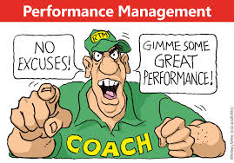

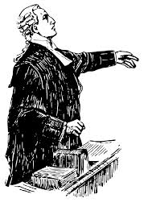
Responses to Managerial Risks
Get Better
– at Societal risk management
- at hazard & risk communication
Get Smarter
– at Managerial risk management
Get out
Get defensive
Get a Lawyer

Slide 19
Questions

