Slide 1


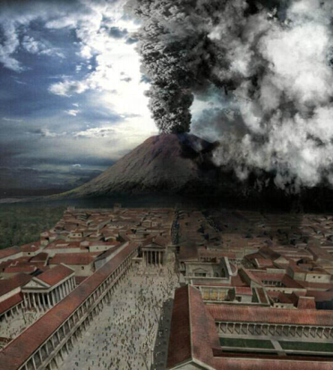
Barcelona 1/41
15 January 2014

Slide 2
The future role of Earth Scientists in the governance of volcanic unrest
And she'll have fun fun fun
Til her daddy takes the t-bird away
From Fun, Fun, Fun by the Beach Boys
Richard Bretton
Supervisors: Dr. J. Gottsmann & Dr. R. Christie
Barcelona 2/41
15 January 2014
richard.bretton@

Slide 3
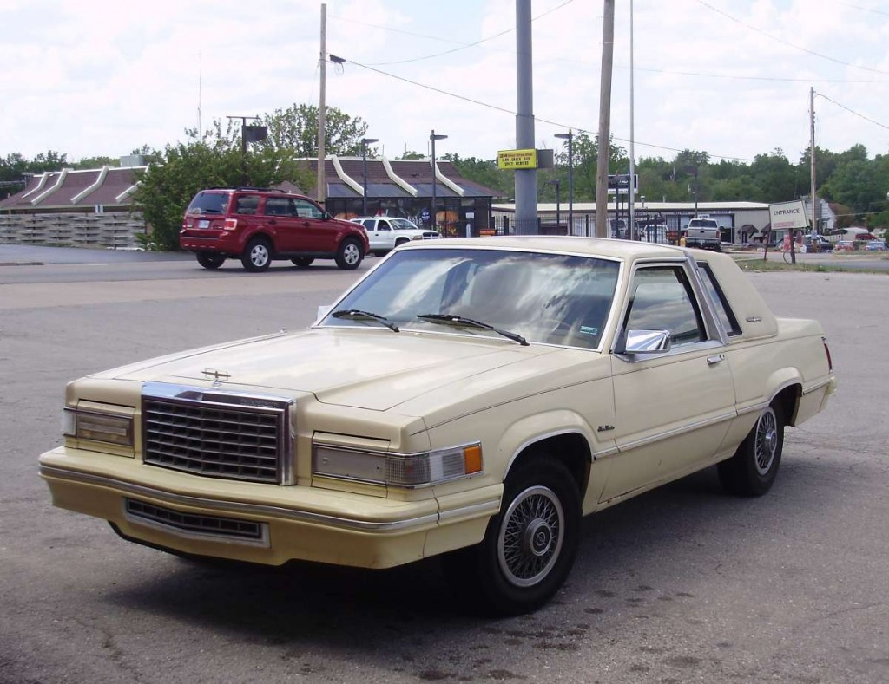

Barcelona 3/41
15 January 2014
This 1983 Ford Thunderbird is showing signs of wear & tear!

Slide 4
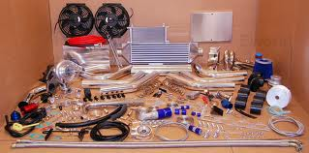
Barcelona 4/41
15 January 2014
We can make many cosmetic & other changes to it but …

Slide 5
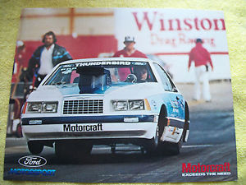
Barcelona 5/41
15 January 2014
Is it fit for purpose in 2014?

Slide 6

Barcelona 6/41
15 January 2014
Should we try a new model in the near future?

Slide 7

Barcelona 7/41
15 January 2014
If yes, what features should we look for
and why?

Slide 8

Barcelona 8/41
15 January 2014
Current risk governance models
Based on 1983 USA National Research Council Report (the Red Book Model)
Linear, Sequential, Not-iterative, Non-Deliberative
  Starts with Hazard Assessment (value-free)
  Proceeds to Risk Assessment (context-rich)
  Proceeds to Risk Management
Communication mostly one-way from scientists to risk managers and interested & affected parties
Notes:
Life in the Middle Ages was hazardous but there is no evidence of the notion of risk existing in any traditional culture. The uncertainties of everyday life (hazards) were expressed and managed through a range of religious and magical beliefs in concepts such as fate, divine providence and luck. They were incapable of management by humans (Giddens 1999; Reith 2004; Gurvitch, 1964; Hacking, 1975).
John Wesley, the Anglican cleric and Christian theologian, viewed the All Saints' Day 1755 earthquake that destroyed Lisbon, Portugal "as God's punishment of the licentious behaviour of believers in Lisbon and retribution for the severity of the Portuguese Inquisition" (Bryant 2005, 3).
Although the Gods always retained prime responsibility, sometimes earthly rulers were attributed with vicarious liability. For example, in Chinese tradition, the emperors were held accountable for events, including natural disasters over which they could not plausibly have exercised any control, on the grounds that the Gods were angry with them or that they had somehow lost the mandate of heaven (Hood 2002, 24).
Time before the End of Tradition

Slide 9

Black Box
A device, system or object in respect of which we know the inputs and outputs but we do not know (or do not need to know) the internal process or workings (Latour 1987)
Barcelona 9/41
15 January 2014

Slide 10
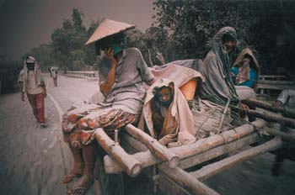
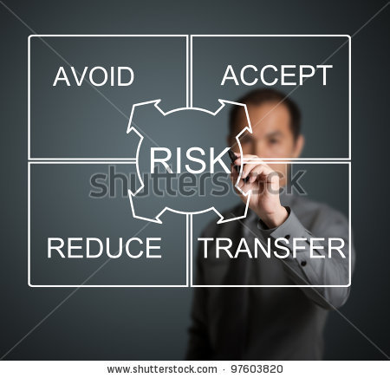
Societal risks (primary)
Institutional risks (secondary)
Barcelona 10/41
15 January 2014

Slide 11
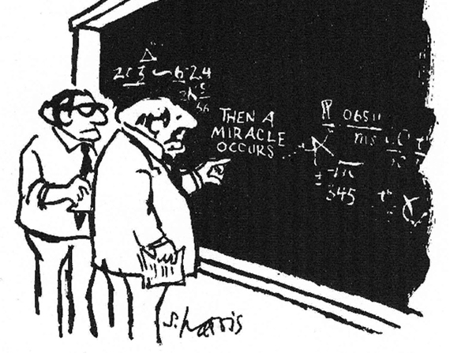
Barcelona 11/41
15 January 2014
Hazard Assessment
Monitoring & other
INPUTS
Hazard assessment
OUTPUTS
I think we should be more explicit here in step two where it says
"THEN A MIRACLE OCCURS")

Slide 12
If we opened the Black Box TODAY, what historic roles and practices would it contain? Hazard Assessment Extreme Case
Barcelona 12/41
15 January 2014
Hazards | Objective Absolute Truths (with no or little subjective content) capable of characterisation
Hazards - Uncertainties | Epistemic, Aleatory, Limited acknowledgement of Limitations, No clear Assumptions

Slide 13
Barcelona 13/41
15 January 2014
Experts - Role | "Detached observer"
Experts – Output (Impact) | "Good Hazard Characterisation" for use by separate Risk managers

Slide 14
Barcelona 14/41
15 January 2014
Experts – Output values | Independent, Purely Scientific, Appropriate, Precise, Adequate, Socially & Politically Neutral, Unbiased, Objective, Accurate, Truthful, Correct, Trusted, Respected
Experts - Appearance | Superior, Powerful, Controlling, Arrogant, Contemptuous, Distant, Secretive, Uncaring, Optimistic about their Values

Slide 15
Barcelona 15/41
15 January 2014
Experts - Process | Top-Down, Distant & Separate from Sequential Risk Assessment Unaccountable - Not Recorded, Transparent, Open, Accessible, Democratic, Auditable
Experts – External scrutiny | Direct by peer review, Occasional by public & media None by legal & regulatory authorities (exception Human Rights cases, L'Aquila trial, Garcés v Chile)

Slide 16
Barcelona 16/41
15 January 2014
Experts - Governance | No self-regulation? No agreed professional standards?
Experts – Behaviour | Societal risks MORE important than Institutional risks - Little evidence yet of Blame-related behaviours

Slide 17
Barcelona 17/41
15 January 2014
Risk managers - Role | Appoint good experts & accept their expert Output
Public - Appearance | Inferior, Unscientific, Inappropriate, Unsophisticated, Cynical, Wrong
Communication | Powerful Truth telling/educating weak/ignorant Risk managers & Public Social Science end-of-pipe bolt-on to assist "education"

Slide 18
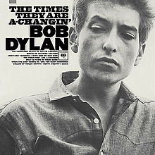
Barcelona 18/41
15 January 2014

Slide 19
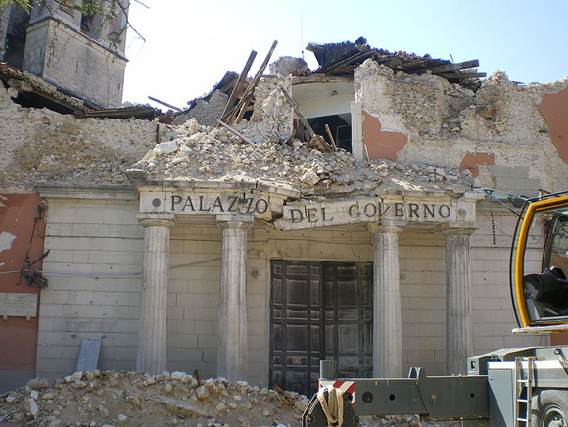
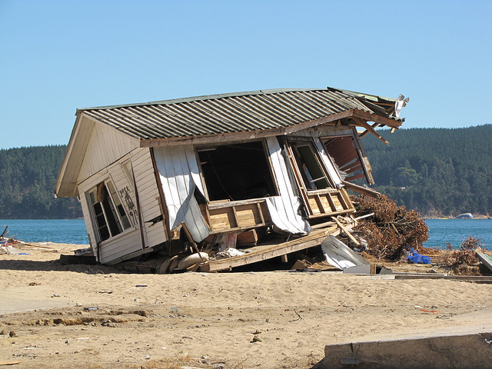
Possible drivers for change
Barcelona 19/41
15 January 2014
Changing legal expectations of governance | National Governance laws L'Aquila, Italy; Garcés v Chile International Human Rights Oneryldz v Turkey 2005 Budayeva v Russia 2008 Kolyadenko v Russia 2012

Slide 20
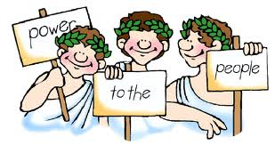
Barcelona 20/41
15 January 2014
Changing general expectations of governance | Trend towards more open & transparent government with goals of : Openness & Transparency Involvement Proportionality & Consistency Evidence Responsibility & Accountability National Freedom of Information laws (supported by International Human Rights conventions & case law Claude Reyes et al. v Chile 2006)

Slide 21
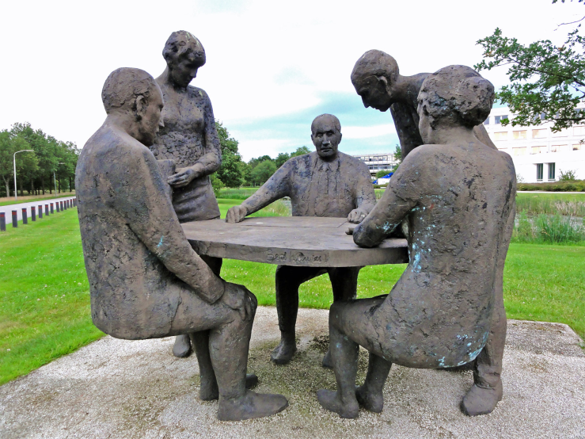
Barcelona 21/41
15 January 2014
Changing general expectations of governance | In democratic societies, more "deliberative & inclusive" processes have been suggested Deliberation advocated: as an alternative or an addition to purely analytical procedures of both assessing & managing risk to help improve accountability & transparency

Slide 22

Barcelona 22/41
15 January 2014
Changing general expectations of governance | Deliberation in risk governance: Who – Various combinations of scientific & technical specialists, risk managers, interested & affected parties Why – To increase understanding & to arrive at substantive decisions What - Roles, subjects, methods, analytical results How – Discuss, ponder, exchange observations & views, reflect upon information/judgements, & persuade about matters of mutual interest Form – Formal/Informal negotiating, mediation, debating, consulting, commenting

Slide 23
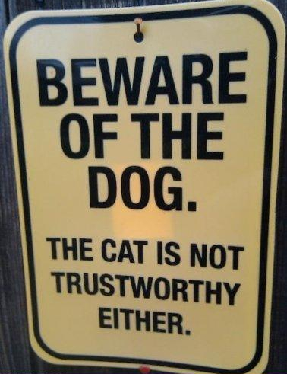
Barcelona 23/41
15 January 2014
Changing status & role of scientists | In many countries, less respect for: Hierarchical authority Social institutions Scientific communities Science – Knowns less complete, More unknowns BUT ALSO… More risk anxiety Higher expectations of governance based on perception of better science

Slide 24
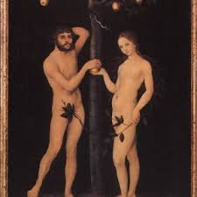
Barcelona 24/41
15 January 2014
Changing status & role of scientists | Emerging discourse about the continued suitability of traditional role of earth scientists as "detached observers" limited to providing context-free (value-free) hazard assessments Should they lose their pretensions to be "innocent & apolitical" & become "participant-observers or activists"?

Slide 25
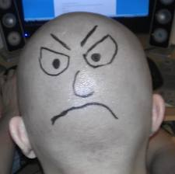
Barcelona 25/41
January 2014
Growing tensions in practice | L'Aquila trial, Italy Responses from 35+ organisations US observatory practices may offend US legal framework (Fearnley 2013) Mismatch between knowledge/experience/competence of hazard assessors & public risk managers Poor communication & mismatch of expectations…or growing signs of "blame-related" behaviour!

Slide 26
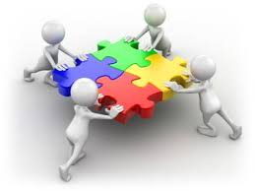
Barcelona 26/41
January 2014
Growing appreciation of the role of social & other sciences | In future, a multi-disciplinary approach will be important with knowledge input from: Economics Politics Sociology Geography Psychology Ethics Law History Anthropology Archaeology

Slide 27
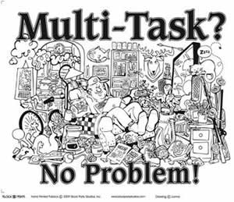
Barcelona 27/41
January 2014
Growing appreciation of the role of social & other sciences | In future, a multi-disciplinary approach will be important with roles for experts in: Weather Signal processing & data analysis Agriculture Civil & Structural engineering Human & Animal health Telecommunications Public communication Internet & Social media Cross border & cross hazard management

Slide 28
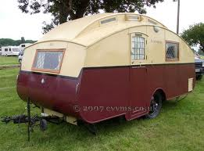

Barcelona 28/41
January 2014
Growing appreciation of the role of social & other sciences | In future, social science input will be seen as not just… an end-of-line bolt-on to provide a better way to get the agreed message across… but integral to the whole process contributing to the production & transfer of knowledge and the making of risk decisions

Slide 29

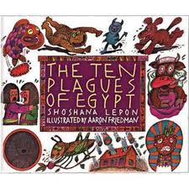
Barcelona 29/41
January 2014
Widening reach of governance | In the future, risk governance practices may reflect a growing understanding of : Secondary & Tertiary risks Cross-border risks Global risks or an Holistic (coupling) approach to multiple hazards (volcanos + earthquakes + floods + tsunamis + climate change)

Slide 30
Barcelona 30/41
15 January 2014
Should we try a new model in the near future?
Yes

Slide 31
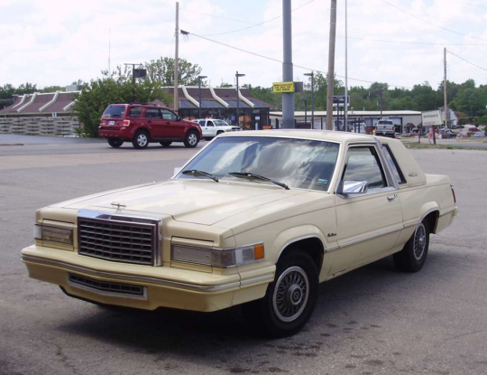
Barcelona 31/41
15 January 2014
The traditional 1893 model (linear/sequential, narrow):
Fails to:
  identify & answer the Q's that users see as relevant – a failure of integration
  reflect important perspectives & concerns
Restricts participation
Risk Characterisation (RC) - a summary of scientific information for the use of a decision maker

Slide 32

Barcelona 32/41
15 January 2014
RC's are not decision-driven activities
They fail because they provide scientific information:
in a way that leads to unwise decisions; and/or
that is not useful to decision makers

Slide 33

Barcelona 33/41
15 January 2014
The differences in the new model
Who is involved
What information is summarised
How information is summarised

Slide 34
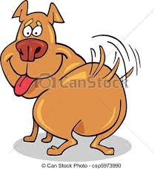
Barcelona 34/41
15 January 2014
RC is seen as:
Broader process
Interaction of 2 equally important complimentary approaches to gaining knowledge, forming understandings of it & reaching agreement among people
    Analysis & Deliberation (A&D)
Decision-driven activity directed toward:
  informing choices; and
  solving problems
Not only the end of the analytical process
but an important shaper of it
The tail that wags the whole dog!

Slide 35

Barcelona 35/41
15 January 2014
RC requires:
Broader understanding of consequences to interested & affected people (IAP)
Input from and participation by full & diverse spectrum of IAP, decision makers, specialists, etc.
A & D process that is early-starting, explicit, flexible, mutual & recursive (analysis deliberation) & purposeful

Slide 36
Governance 36/41
15 January 2014

Slide 37
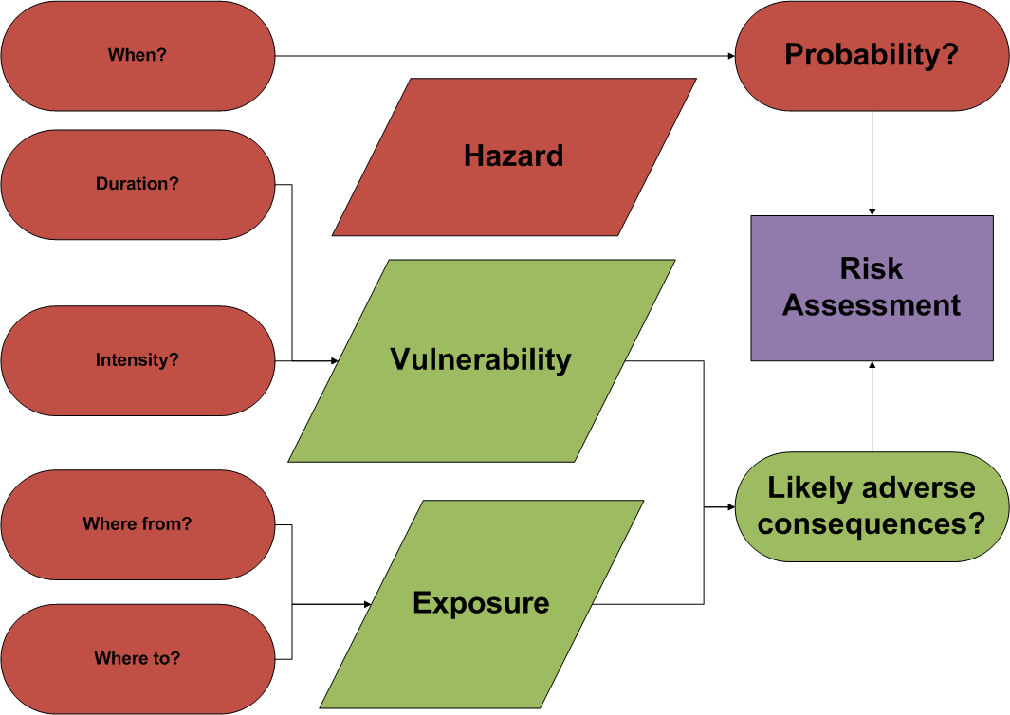
Governance 37/41
15 January 2014

Slide 38
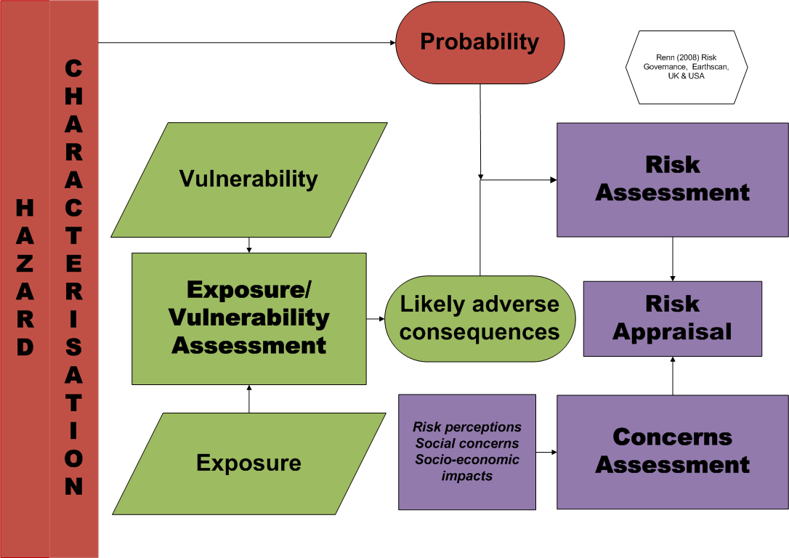
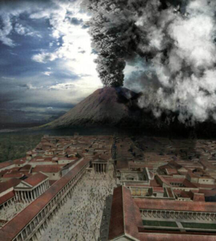
Governance 38/41
15 January 2014

Slide 39
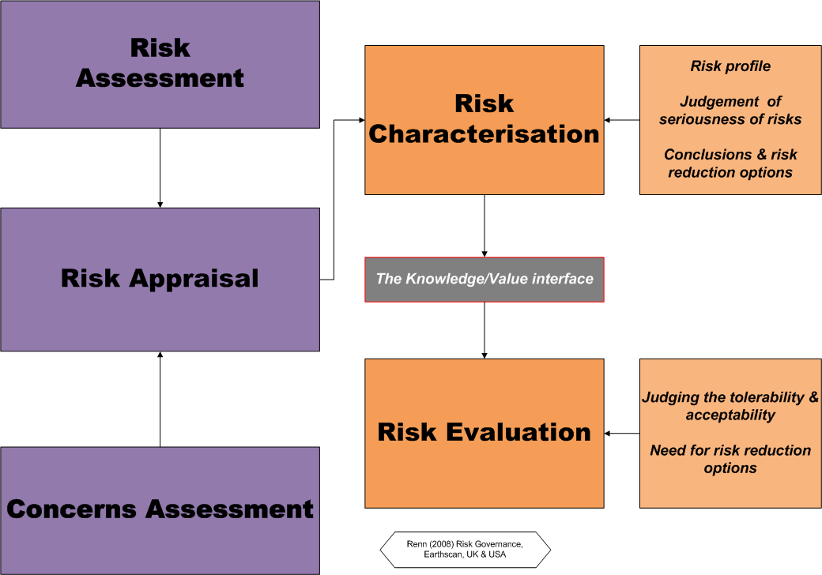
Governance 39/41
15 January 2014

Slide 40
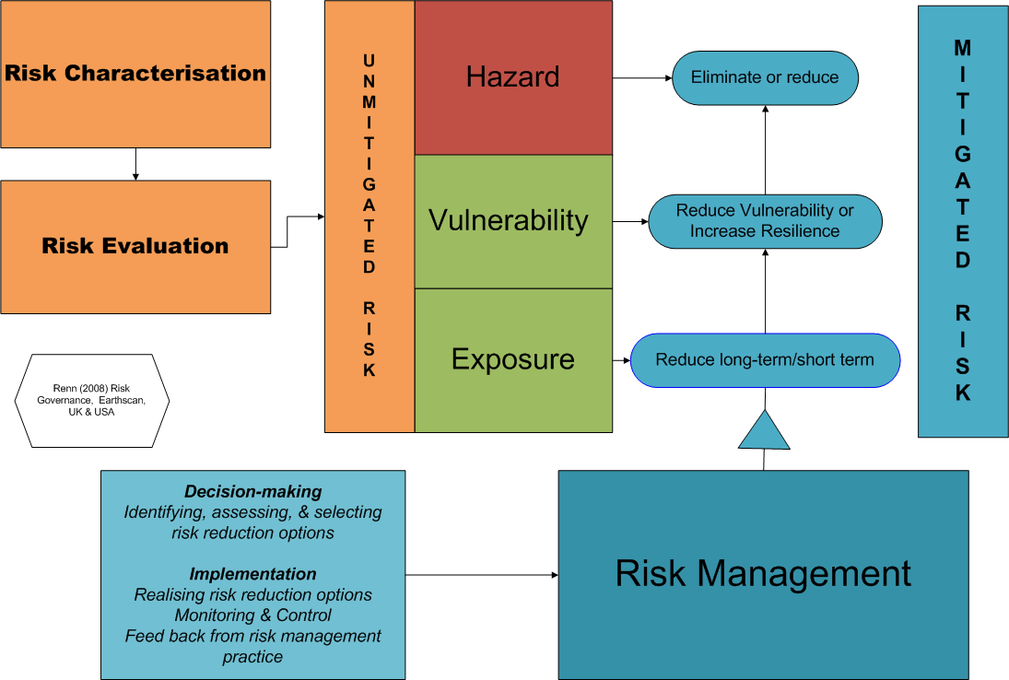
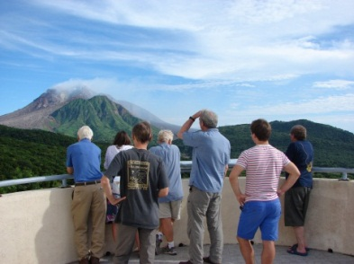
Governance 40/41
15 January 2014

Slide 41
Governance 41/41
15 January 2014
Questions

