Slide 1
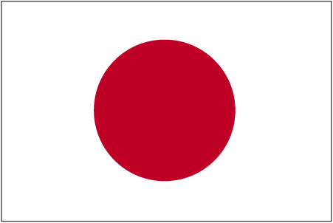
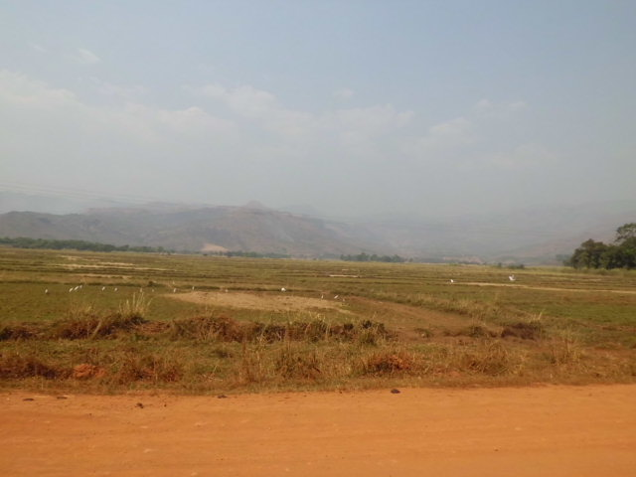





CVL8 Workshop, July 28, 2013; 10:30 – 10:50
Japan
Cameroon
Physico-chemical and isotopic composition of some lakes and springs in the Bamenda Highlands, North West Cameroon
MJ Wirmvemª*, T Ohbaª, WY Fantong^{b}, SN Ayonghe^{c}, JY Suila^{d}, ANE Asaah^{e},
K Asai^{f}, G Tanyileke^{b}, JV Hell^{b}
_____________________________________________________
ªTokai University, Japan, ^{b}IRGM, Cameroon, ^{c}University of Buea, Cameroon ^{d}G.B.H.S. Atiela, Cameroon,
^{e}Tokyo Institute of Technology, Japan, ^{f}Geo-Science Laboratory, Nagoya, Japan

Slide 2
Presentation Outline
Introduction
Objectives
Methodology
Results and Discussion
Conclusions

Slide 3
Introduction
The Cameroon Volcanic Line (CVL), an approximately 1,600 km long chain of Cenozoic volcanic centres, is seismically active, highly faulted & contains numerous lakes and springs (Tanyileke et al., 1994; Aka et al., 2001).
Hydrology study of these waters is necessary given the lethal incidence of Lakes Monoun (1984) and Nyos (1986) along the CVL.
We present the physico-chemical and stable isotope compositions of Lakes Oku, Bambili and Ber and some springs in the Bamenda Highlands.

Slide 4
Objectives
Physico-chemical characteristic of lakes & springs.
Recharge mechanism.
Major controls on water chemistry.

Slide 5
Introduction: The study area & sampling points
Lake Oku
“Lake Ber”
Lake Bambili
Fig. 1 Map of the study area showing drainage, relief and rain sampling point.

Slide 6
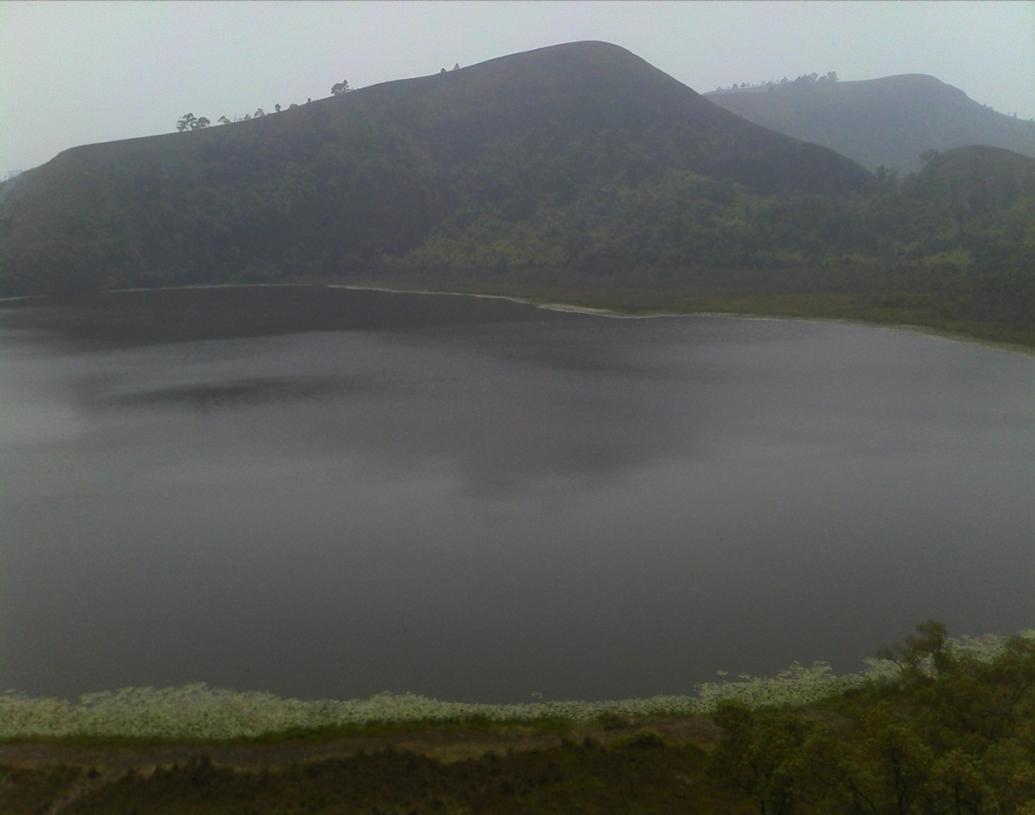
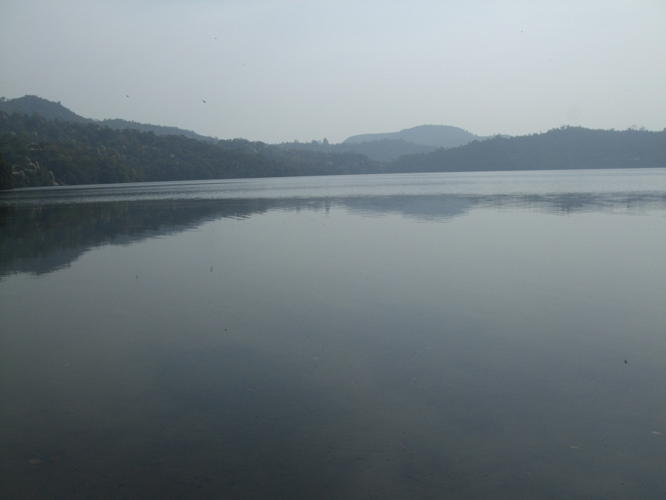
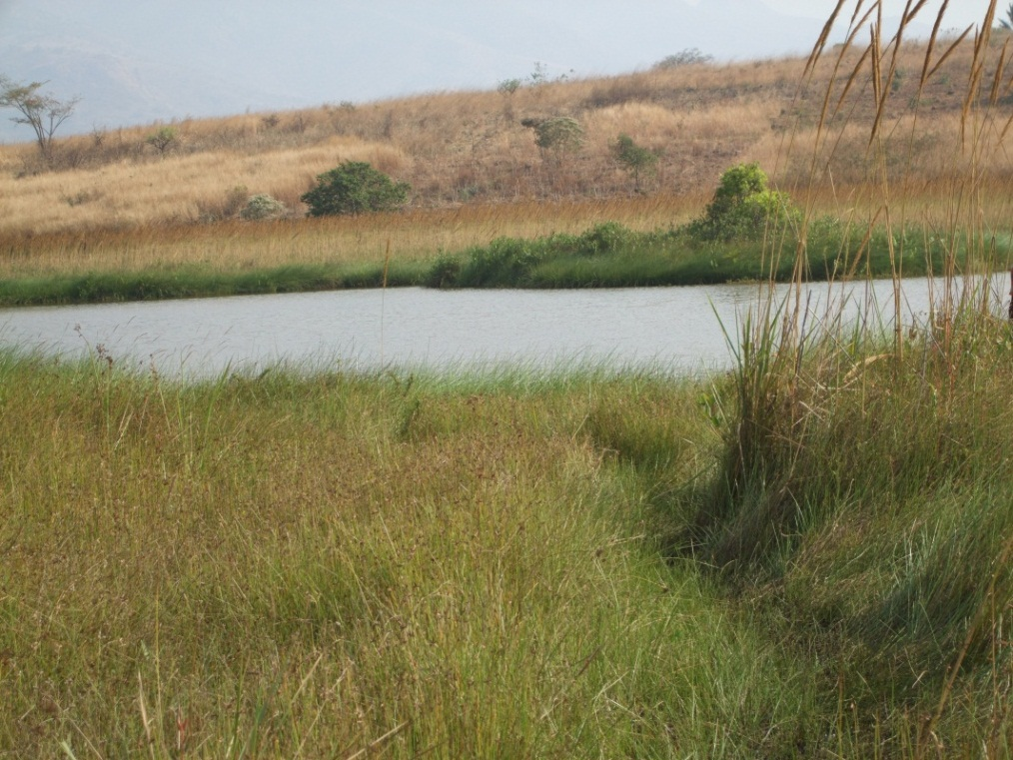
Introduction: Images of lakes sampled
Lake Bambili (2,272 m asl.)
Lake Oku (2,243 m asl.)
Lake Ber (1,181 m asl.)
Fig. 2 Images of lakes and altitude

Slide 7
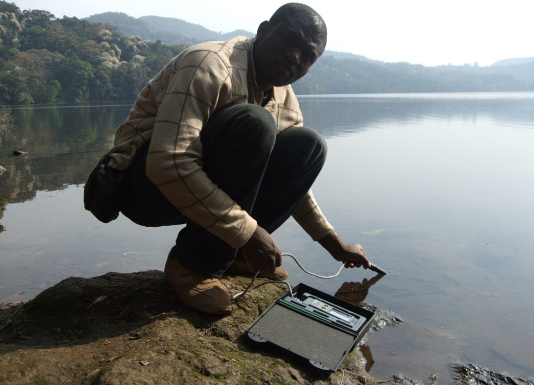
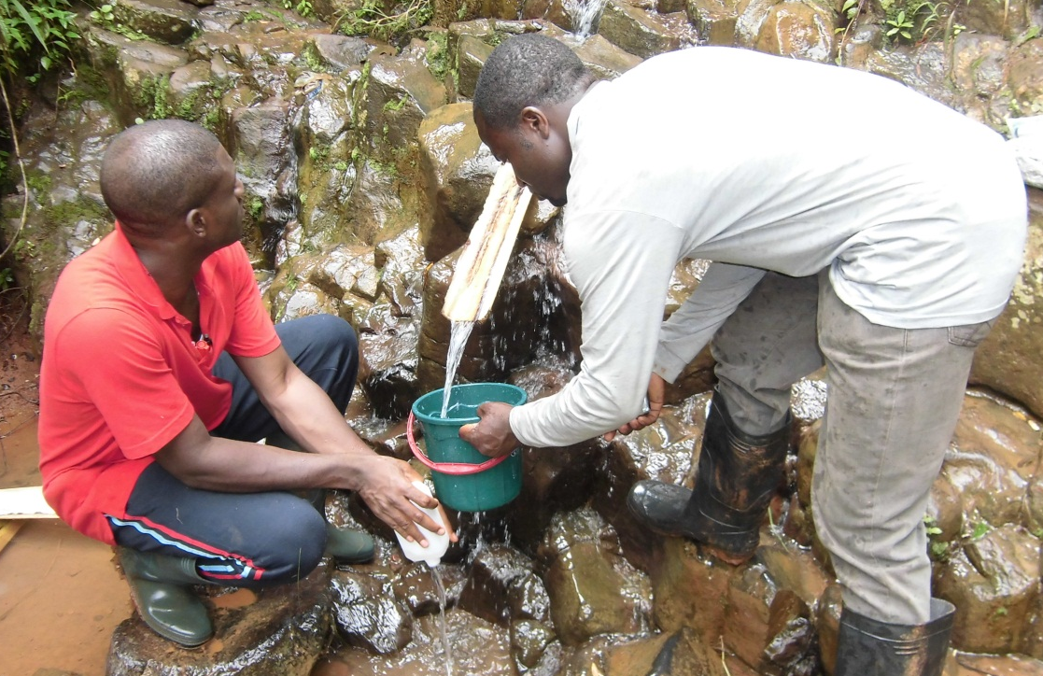
Methods of study: Fieldwork
January 2012
Sampling of lake water and springs in the environs.
Physical parameters (T, pH & EC/TDS) measured with HI991300 metre.

Slide 8
Methods of study: Laboratory analyses
Tokai University, Japan
F, Cl, SO₄ & NO₃: DIONEX ICS-900 Ion Chromatography.
Na, K, Ca & Mg: AAS contrAA 700; Silica: ICP-MS.
δ¹⁸O & δD: Cavity Ring-Down Spectrometer (L2120-i) from PICARRO.
The ratios D/H and ¹⁸O/¹⁶O were expressed as ‰ deviation relative to V-SMOW:
δ (‰) = R_{(sample)} /R_{(V-SMOW)} -1*1000.
Total analytical precisions were better than ±0.05 ‰ (δ¹⁸O) and ±0.12 ‰ (δD).

Slide 9

Results & Discussion: physical parameters
T: 20ºC
pH: 7.8
EC: 44 µS/cm
TDS: 29 mg/l
T: 22ºC
pH: 8.4
EC: 33 µS/cm
TDS: 21 mg/l
Lake Bambili
Lake Oku
T: 27ºC
pH: 6.3
EC: 32
TDS: 21 mg/l
T: 23ºC
pH: 5.9
EC: 49 µS/cm
TDS: 32 mg/l
Lake Ber
All spring water (n=30)

Slide 10
Fig. 3 Major cations in lakes and spring water showing Na and Ca dominance.

Slide 11
Fig. 4 Major anions in lakes and spring water showing HCO₃ dominance.

Slide 12
Results & Discussion: Dominant ions
Ca-HCO₃
CaMg-HCO₃
Lake Bambili:
Lake Oku:
Na-HCO₃
All springs (n=30):
Na-HCO₃
Dominant ions of Lakes Bambili & Oku are similar to those of Lakes Nyos & Monoun (Kusakabe et al. 1989) but relatively low concentrations.
Lake Ber

Slide 13
Results & Discussion: Recharge origin
Fig. 5. Cross plot of δ¹⁸O vs. δD of lake and spring waters along the LMWL (Wirmvem et al., 2013).
Meteoric origin; rapid recharge of springs; significant evaporation from lakes.

Slide 14
Results & Discussion: Chemical evolution
Fig. 6. Increase in concentrations of cations from rain to lakes and springs.
Chemical enrichment of lake and spring water after precipitation recharge.

Slide 15
Results & Discussion: Chemical control
Fig. 7. Plot of δ¹⁸O versus TDS showing an inverse relationship
Lake and spring water chemistry is not influenced by evaporation.

Slide 16
Results & Discussion: Chemical control
Fig. 8. Plot of total cations as a function of alkalinity showing a 1:1 relationship.
Lake & spring water chemistry is influenced by silicate weathering (Kim et al 2002).

Slide 17
Results & Discussion: Chemical control
Fig. 9. Plot of SO₄²⁻+HCO₃⁻ vs. Ca²⁺+Mg²⁺ a showing deficiency in Ca²⁺+Mg²⁺.
Excess of SO₄+HCO₃ suggests incongruent dissolution of silicates (Fisher & Mullican, 1997).

Slide 18
Results & Discussion: Chemical control
Fig. 10. Plot of Na⁺ against Cl⁻ showing excess Na⁺ over Cl⁻ in lakes & springs.
High Na⁺ relative to Cl⁻ suggests addition of Na⁺ from Na-rich feldspars (Gibbs, 1992).

Slide 19
Results & Discussion: Chemical control
Evaporation dominance
Lake Ber
Rock dominance
Lake Bambili
Lake Oku
Rain dominance
Fig. 11. Gibbs diagram of Na⁺/(Na⁺+Ca²⁺) vs. TDS of lakes & springs.
Controls on lake & spring water chemistry are precipitation and silicate dissolution.

Slide 20
Conclusions
The lakes are generally alkaline while springs are barely acidic.
Dominant ions are Na, Ca and HCO₃ as in Lake Nyos (Kusakabe, 1989).
Lakes and springs are of meteoric origin.
Lakes are subjected to varied degrees of evaporation.
Controls on lakes and springs water chemistry are precipitation and silicate weathering.
Low TDS in both sources indicates rain dilution, low dissolution of silicates and short circulation.

Slide 21
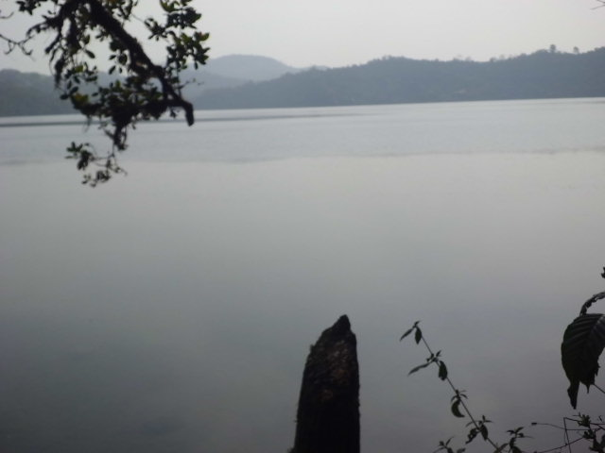

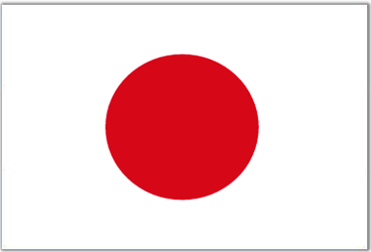
ごせいちょうありがとおございました
友好
友好
Thanks for the Kind Attention
judevom@yahoo.co.uk
終

